Slide 1

Publications Network Analysis
Tracking & Evaluation Team
Jeffrey Smith, PhD Josephine McKelvy, PhD
Notes:
Hello! My name is Josephine McKelvy from the Tracking & Evaluation team, and I'll be presenting findings from the network analysis conducted by our former analyst, Jeffrey Smith, on RADx-UP publications.

Slide 2

Overview
Study Aims
Data Collection and Analysis
Results​
Patterns of Scientific Collaboration​
Contents of Scientific Output (to be presented in Part 2 of NIH meetings)​
Conclusions & Key Takeaways
Next Steps​
Notes:
In this presentation, I'll touch on our study aims for analyzing scientific collaboration (or co-authorship) among RADx-UP projects as well as describe our data collection and analysis methods.​
While we have results on patterns of collaboration and the content of scientific output (or publications), I'll focus on the results, key takeaways & next steps of the patterns of scientific collaboration in this presentation.
We presented on the contents of publications at the NIH meetings

Slide 3



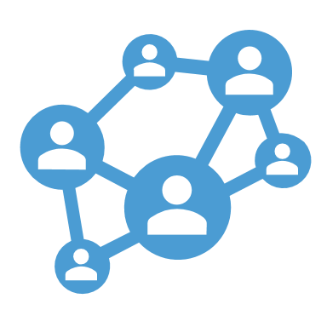
Study Aims: Advantages of Scientific Collaboration​
Cross-fertilization & innovation
Productivity
Accuracy
Social Capital
Notes:
Why study scientific collaboration or co-authorship? Scientific collaboration offers many advantages. It:​
increases research productivity in terms of publications and other outputs​
increases accuracy and reduces errors when investigators study the same issue through multiple methods, samples, and settings​
enhances cross-fertilization of knowledge across disciplines and fosters innovation in research​
promotes social capital for teams that collaborate beyond this project​
​
A social network analysis can reveal mechanisms that drive collaborative work. We can explore opportunities for collaboration among researchers to create new knowledge and innovate using this approach.
From that analysis, we can ask:​
How strong are the connections (or ties) between collaborators?​
Are research networks diverse?​
Who contributes to scholarly output?​

Slide 4
Data Analysis: Network Analysis
Example Map of a Scientific Collaboration Network
Node: Author X
Node: Author Y
(Edge)
(Edge)
Node: Paper Z
Author X and Author Y are co-authors on Paper Z, a RADx-UP scholarly product.
Notes:
In these findings, imagine that a network is a set of relationships between co-authors on a given paper (or scholarly output). There is an example of that visualization on the left. The collection of all authors and their connections forms a map that can reveal patterns of scientific collaboration. ​
​
Now let’s zoom in on this top right corner of the map, circled in orange. ​
The nodes (or dots) represent authors and papers. The smaller light blue nodes are authors while the larger dark blue dots are papers.​
The edges (or lines) represent the connections between co-authors on a paper. ​
[The width of the edges (or thickness of the lines) represent the number of articles that researchers have co-authored on)]​
So in this example, Author X and Author Y are co-authors on Paper Z, a RADx-UP scholarly product.
​
​
​
​

Slide 5


Data Collection: Patterns of Scientific Collaboration
Data Collection
Data Curation
Network Analysis
RADx-UP publications (n=76)
Quality-controlled publications (n=70)
Assess strength and diversity of networks
(collected as of 03.15.2022)
Notes:
So what were our methods of data collection to run a network analysis?
First is data collection. We gathered information about scholarly products as data sources for this analysis, and these products can include:
published journal articles,
conference papers (already presented and pending)
grants
This might sound familiar if you completed the quarterly publications tracking survey that we send out to RADx-UP project leads. We also run automated searches of RADx-UP grant numbers in PubMed and Scopus databases.
[Information about scholarly outputs can include:
the authors,
author affiliation,
article title,
article abstract,
keywords, etc. ]
From Sep 2021 to Mar 15, 2022, there were 76 RADx-UP publications. To date there are now around 200 RADx-UP publications. We presented these findings to the NIH back in January of 2023 and plan to run a new network analysis on scholarly products published in the last year (from March to March), so more analyses and findings to come from our new analyst!
Next is Data Curation. In our quality control, we excluded 6 papers that did not focus on COVID-19 specifically and coded coauthors’ affiliations as academic, healthcare, government, professional, community, or K-12 schools
[Exclusion criteria: The criterion for exclusion was whether articles dealt with covid at their core or not. For example, one article’s key topic was diabetes. However, its abstract also mentioned new medical technologies are being used during the covid pandemic. If the discussion of covid was only tangential (as in the example discussed), the article was coded as irrelevant for covid. Published articles included in the corpus have information about their title and their abstract and/or keywords.]
Finally, we used exploratory Network Analysis to assess the strength and diversity of co-authorship networks.

Slide 6
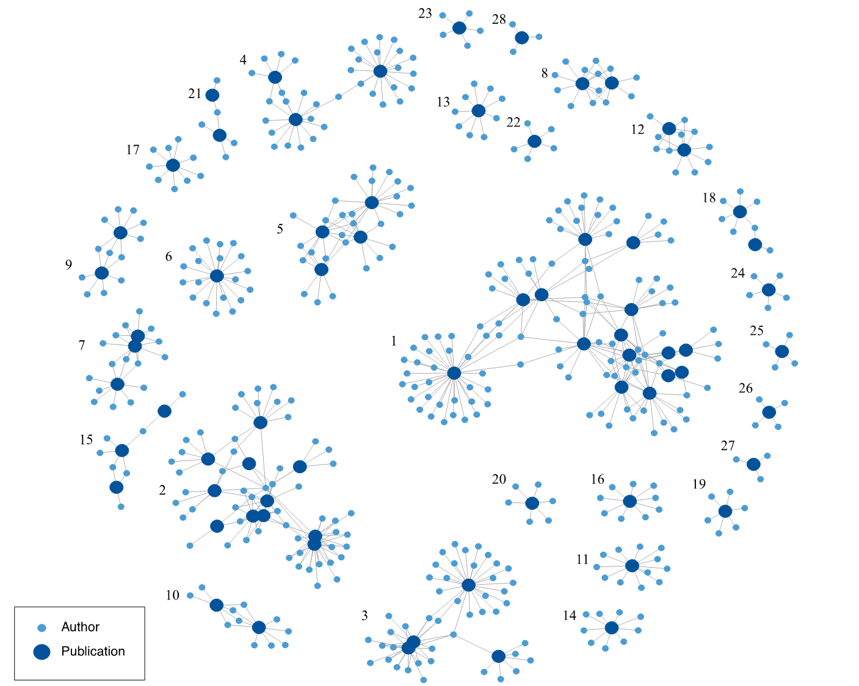
Results: 28 clusters
Notes:
[The methodology employed includes 3 steps/phases:
Data Curation in which irrelevant articles are removed,
Exploratory Analyses and assessment of preliminary results is conducted,
Defining Final Strategy: an adaption of the analytical strategy based on those preliminary results.]
So what did we find?
Our results show that, among the 70 RADx-UP papers that focused on COVID-19, there were 28 clusters of co-authors, largely based on existing RADx-UP project teams. They are numbered by size in this slide.
[In the Sept. 29, 2021 (to Dec 31, 2021?) dataset of 26 COVID-relevant papers, scientific collaboration was grouped into 16 co-authorship clusters that also mapped strongly onto existing projects.]
Almost half (13, or 47%) of the 28 clusters published anywhere from 2 to 15 papers, as indicated by the larger dark blue dots.
We’ll take a deep dive into Cluster No. 2 circled in orange

Slide 7
Results: A Deep Dive Example
Notes:
Cluster 2 (the second largest cluster) represents publications and authors from Project 20: Improved Testing for COVID-19 in Skilled Nursing Facilities: IMPACT-C
This cluster (2) shows 54 co-authors (represented by the smaller light blue dots) distributed among 11 papers (represented by the larger dark blue dots). We’ve included a summary of each paper, which centered on improved COVID-19 testing in skilled nursing facilities. This map indicates that this is a:
This is an example of a highly integrated project across papers and authors that influenced collaboration on publications.
But many authors still isolated to a single paper (like the papers on the top and outer perimeter), with a few linking co-authors (toward the middle and bottom right) that connect a few papers together in this cluster.

Slide 8
Degree: # of direct connections
11
1
Researchers collaborated with a median of
11
other authors
10
2
9
X
3
8
4
7
5
6
Fig. 3 Author X and Authors 1-11 are co-authors
Notes:
One measure of interest in Network Analysis is degree, or how many direct connections a person in the network has (or in this case, how many authors collaborated with you).
(Average degree: 14.37)
Researchers are connected to an average of 14 other authors.
There were some outliers (like when a paper may have many, many more co-authors), so we calculated a median degree of 11. That is, researchers are connected to a median of 11 other authors.
So in this figure, Author X and Authors 1-11 have co-authored together.
Some additional details worth noting:
84% of coauthor ties (or the lines between people) are within a single project
[16% of coauthor ties involve multiple projects, or are between projects]
[Most authors collaborated in one paper (2830 pairs).
381 pairs of authors collaborated on 2 papers
43 pairs of authors collaborated on 3 papers
9 pairs of authors collaborated on 4 papers
7 pairs of authors collaborated on 5+ papers]
Again, this is an initial analysis, so coauthorship is minimal.

Slide 9
Results: co-authors from CBOs
Notes:
We also looked at the types of organizations that authors were affiliated with
The light blue dots are authors from academic settings, orange is community-based organizations, green is K-12 schools, purple is healthcare, etc.
22 (or 79%) of the 28 clusters included co-authors from more than one type of organization
but only 5 (or 18%) of the 28 clusters included co-authors from community organizations (which are clusters with orange dots, and also highlighted in orange):
1/Projects 1, 71-79 (right)
4/Proj 14 (top)
6/SYCT (left)
11/Proj 7 (bottom)
17/Proj 4 (top left)
(Not sure what happened to cluster 12/Proj 50)
Still, that's up from only 1 cluster (4/Proj 14; 12/Proj 50) that had community-org co-authors in publications from the prior quarter (Sep-Dec 2021 vs Jan-Mar 2022)
And with the inaugural publication using consortial data, we expect to find even more collaboration and community engagement.
author_affiliations_codebook.xlsx: "Community: Organization with direct relationships with the target population, serves target population at the community level. This could be a non profit but has a community level focus."

Slide 10

Conclusions & Key Takeaways
2+ papers​
Collaborations based on projects​
Collaboration by affiliation​
Notes:
Almost half (13, or 47%) of the 28 clusters published 2 or more (i.e., 2 to 15) papers.​
Collaborations on papers tended to be based on existing projects; or mapped strongly onto projects. ​
84% of coauthor ties (or the lines between people) are within a single project​
We observed relatively few collaborations across projects. [2 (or 7%) of the 28 clusters had 2+ projects]​
[MC: The components largely correspond to RADx-UP projects. There were two article publications that included co-authors from different RADx-UP projects.]​
In terms of collaboration by affiliation, co-authors from different types of organizations did collaborate.​
But community-based organizations were concentrated in a small number of clusters. They were less likely coauthor with academics, compared to authors from healthcare or professional organizations. ​

Slide 11

Next Steps
Cross project & CBO involvement over time​
Causes and interventions for:​
participation rates by type of organization ​
collaboration between projects
Notes:
T&E expects cross project and community-based organizational involvement to increase over time​, especially in our new dataset.
We have already seen increases compared to data from publications tracking in the prior quarter and have a year's worth of new publications to analyze.
T&E will examine possible causes and interventions for:​
differential authorship participation rates by type of organization ​
lack of collaboration between projects. ​
T&E will continue to monitor patterns of scientific collaboration to confirm observed trends​
Our next presentation will focus on the topics or types of content in the scientific output, or publications from RADx-UP projects.​

Slide 12

Discussion
What lessons have you learned from working with community co-authors?
What resources might you need to onboard & engage community partners in scholarly dissemination?
Notes:
1. probes for lessons learned
how they envision CBO co-authors contributing
what does a successful co-authorship look like for them
2. probes for resources
how to onboard CBOs as co-authors
CDCC updates on resources for projects to engage community partners in scholarly dissemination

Slide 13
Josephine McKelvy (josephine_mckelvy@med.unc.edu)
Tara Carr (tara_carr@med.unc.edu)

